Slide 1


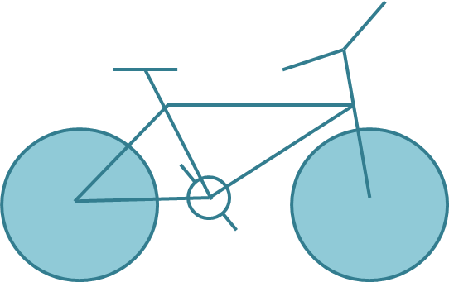
Homework
Draw the following graphics using canvas:

Slide 2
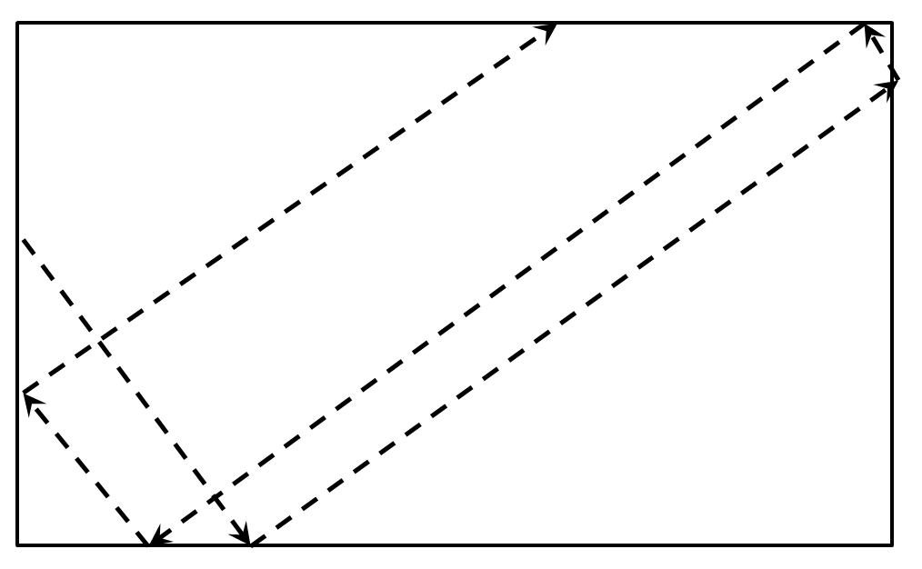
Homework (5)
Draw a circle that flies inside a box
  When it reaches an edge, it should bounce that edge

Slide 3
Homework (7)
*Create the famous game "Snake"
  The snake is a sequence of rectangles/ellipses
  The snake can move left, right, up or down
  The snake dies if it reaches any of the edges or when it tries to eat itself
  A food should be generated
    When the snake eats the food, it grows and new food is generated at random position
  Implement a high-score board, kept in localStorage

